Slide 1


PaNOSC Overview and Status
13 May, 2019
Author: Andy Götz (ESRF)
Role: PaNOSC Coordinator
Place: LEAPS-IT meeting @ PSI
This project has received funding from the European Union’s Horizon 2020 research and innovation programme under grant agreement No. 823852

Slide 2









PaNOSC project - factsheet
Call: Horizon 2020 InfraEOSC-04
Partners: ESRF, ILL, XFEL.EU, ESS, CERIC-ERIC, ELI-DC, EGI
Description: cluster of ESFRI Photon and Neutron sources
Observers/non-funded: GÉANT, EUDAT, national RIs
Linked 3rd parties via EGI: DESY, STFC, CESNET
Status: Started 1/12/2018
Github: https://github.com/panosc-eu
Home page: https://panosc.eu
Twitter: @PaNOSC_eu #PaNOSC
Budget: 12 M€
Coordinator: ESRF
Started: 1/12/2018
Duration: 4 years
Photon and Neutron Open Science Cloud
This project has received funding from the European Union’s Horizon 2020 research and innovation programme under grant agreement No. 823852

Slide 3
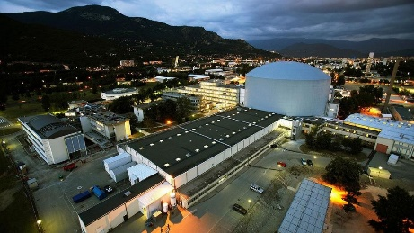
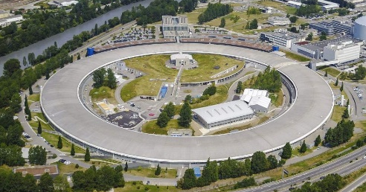
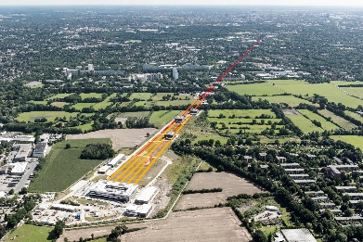




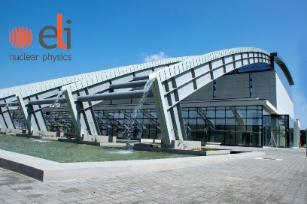


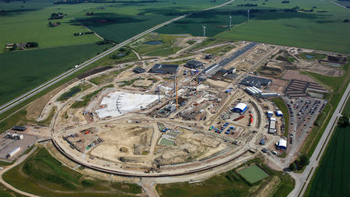

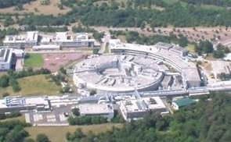

PaNOSC Partners – ESFRI projects
Photon and Neutron Open Science Cloud
This project has received funding from the European Union’s Horizon 2020 research and innovation programme under grant agreement No. 823852

Slide 4
Data is our Product!
Open Data Analysed Data Digital Objects
Federated
catalogues
On-site
data reduction
Reduced Data Archived Data
RIs
Data+software
catalogues
Metadata
catalogues
Raw Data
Publications
AI
On-site
data analysis
Data mining
This project has received funding from the European Union’s Horizon 2020 research and innovation programme under grant agreement No. 823852

Slide 5
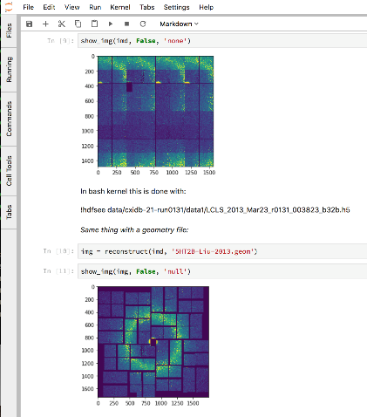
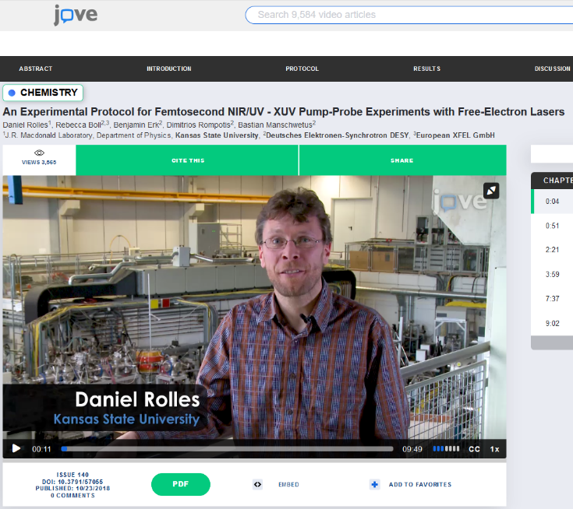
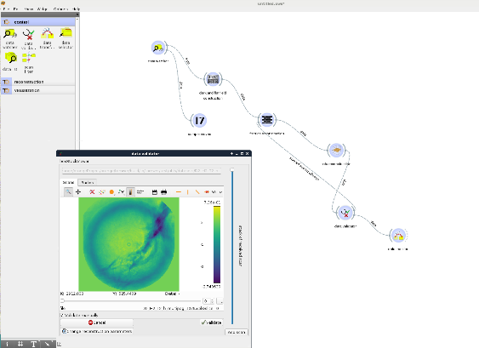
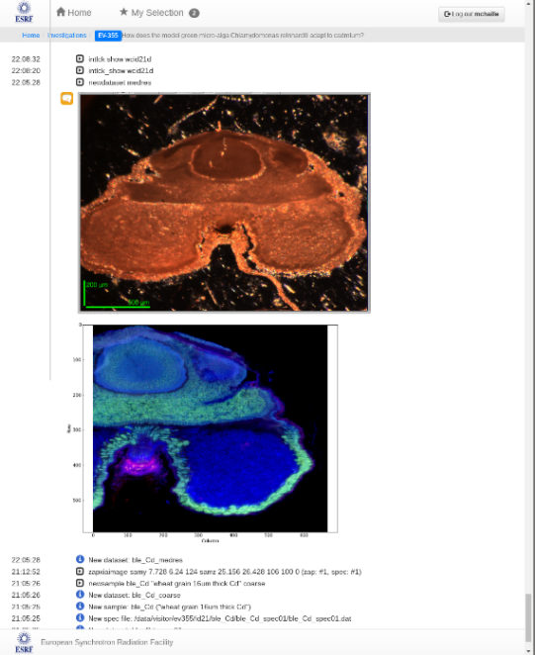
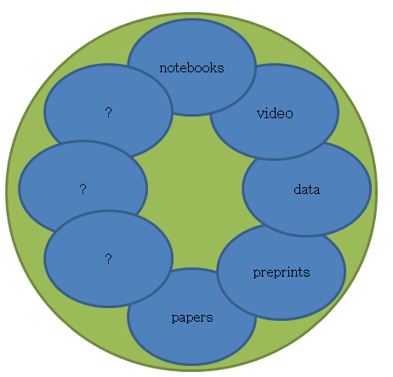
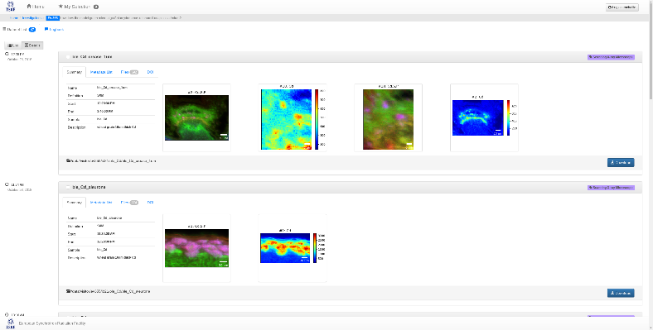
Why – to link all scientific data and output together
Image Source: http://michaelnielsen.org/blog/the-future-of-science-2/
Workflow
Logbook
Software
This project has received funding from the European Union’s Horizon 2020 research and innovation programme under grant agreement No. 823852

Slide 6

Making FAIR a reality for PaNOSC
How to make FAIR reality?
How to make the EOSC reality?
How to make Open Science reality?
PaNOSC will build on and help make FAIR, EOSC and Open Science become reality for the Photon and Neutron community
PaNOSC developments: new Data Policy framework, Nexus-compliant metadata, e-logbook, certified data catalogues, search API, data services, linking to EOSC, etc.
This project has received funding from the European Union’s Horizon 2020 research and innovation programme under grant agreement No. 823852

Slide 7
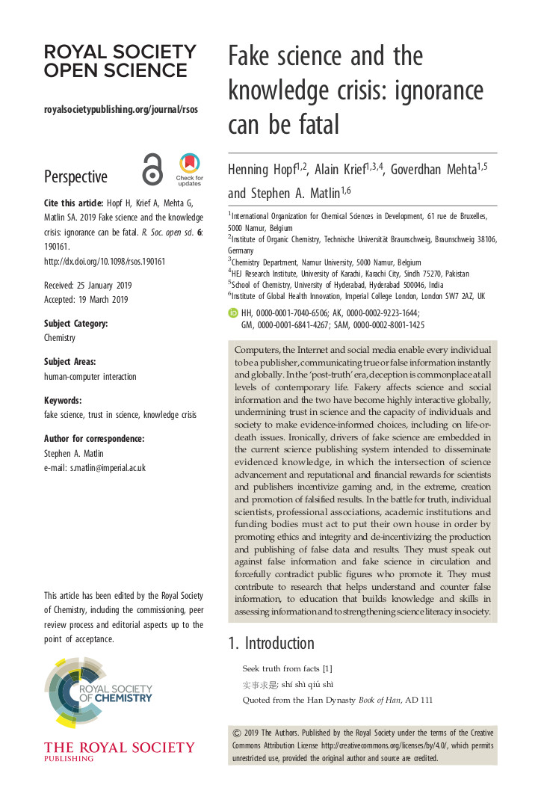
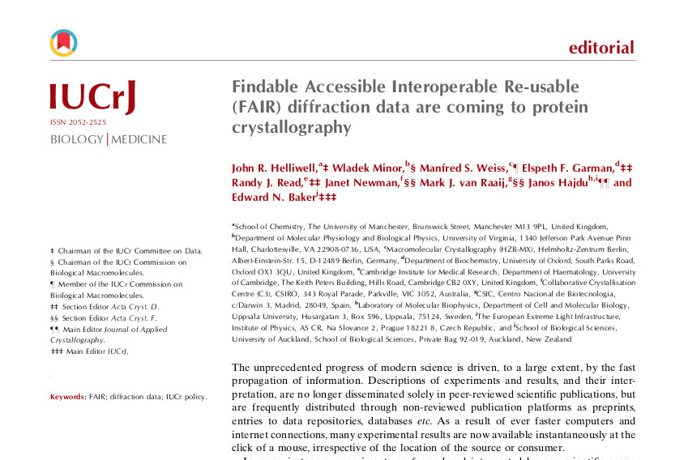
PaNOSC, ExPANDS and EOSC are about making science RELIABLE and REPRODUCIBLE
This project has received funding from the European Union’s Horizon 2020 research and innovation programme under grant agreement No. 823852

Slide 8
PaNOSC KPIs
 | ILL | ESRF | CERIC | XFEL | ELI | ESS
Data/year 2018 | 0.2 PB | 8 PB | 1 PB | 3PB | < 1 PB | 0
Data/year 2023 | 0.6 PB | 50 PB | 15 PB | 100 PB | 10 PB | < 1 PB
Data Policy 2018 | 2011 | 2016 | 2014(3/8) | 2017 | in prog | 2017
Data Policy 2023 | 2011 | 2016 | 2019 | 2017 | 2019 | 2017
Metadata catalogue 2018 | Local | Icat | Local | myMdC | No | SciCat
Metadata catalogue 2023 | Local | Icat | Icat | myMdC | [TBD] | SciCat
Metadata definition 2018 | Nexus | Nexus | custom | myMdC | ? | Nexus
Metadata definition 2023 | Nexus | Nexus | Nexus | Nexus | [Nexus] | Nexus
DOI 2018 | yes | yes | no | yes | no | yes
DOI 2023 | yes | yes | yes | yes | yes | yes
This project has received funding from the European Union’s Horizon 2020 research and innovation programme under grant agreement No. 823852

Slide 9
PaNOSC KPIs
 | ILL | ESRF | CERIC | XFEL | ELI | ESS
Open Data 2018 | 100s | 2 | 0 | 10s | 0 | 0
Open Data 2023 | 1000s | 1000s | 100s | 1000s | 100s | 10s
Data Services 2018 | Pilot | In progress | Remote | In progress | ? | In progress
Data Services 2023 | Desktop Jupyter | Jupyter Desktop | Jupyter Desktop | Jupyter Desktop | Desktop Jupyter | Jupyter Desktop
Common data API 2018 | No | No | No | No | No | No
Common data API 2023 | Yes | Yes | Yes | Yes | Yes | Yes
User training 2018 | No | No | No | No | No | No
User training 2023 | Yes | Yes | Yes | Yes | Yes | Yes
This project has received funding from the European Union’s Horizon 2020 research and innovation programme under grant agreement No. 823852

Slide 10
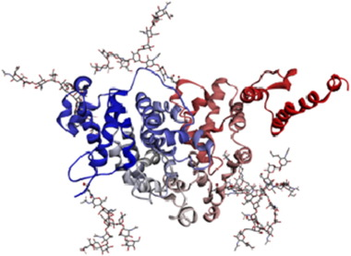
Sharing data across domains & sites
Find all xray diffraction datasets of Afamin protein
How many NMR datasets are there for Afamin and Wnt proteins ?
This project has received funding from the European Union’s Horizon 2020 research and innovation programme under grant agreement No. 823852

Slide 11
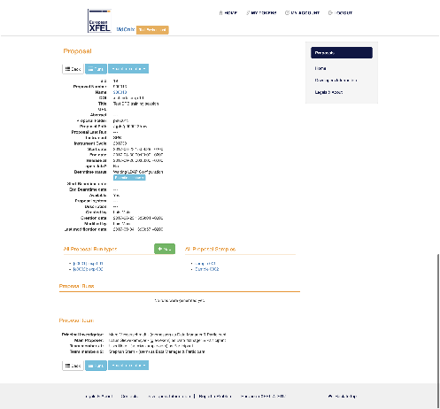
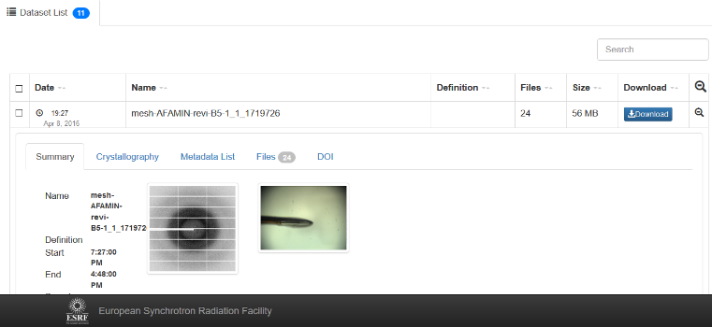
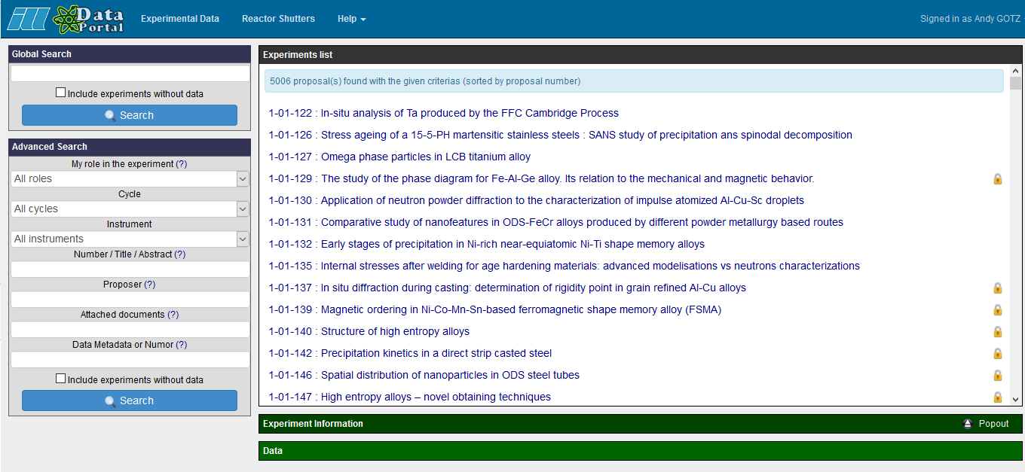
PaNOSC has 6 data catalogues with different APIs + UIs
ESRF
(icat)
CERIC
(icat)
ESS
(SciCat)
ILL
(local)
ELI
(tbd)
XFEL
(MyMdc)
This project has received funding from the European Union’s Horizon 2020 research and innovation programme under grant agreement No. 823852

Slide 12


PaNOSC is implementing a common API searchable across sites
Common API to search across all PaNOSC catalogues
ESRF
(icat)
CERIC
(icat)
ESS
(SciCat)
ILL
(local)
ELI
(tbd)
XFEL
(MyMdc)
This project has received funding from the European Union’s Horizon 2020 research and innovation programme under grant agreement No. 823852

Slide 13
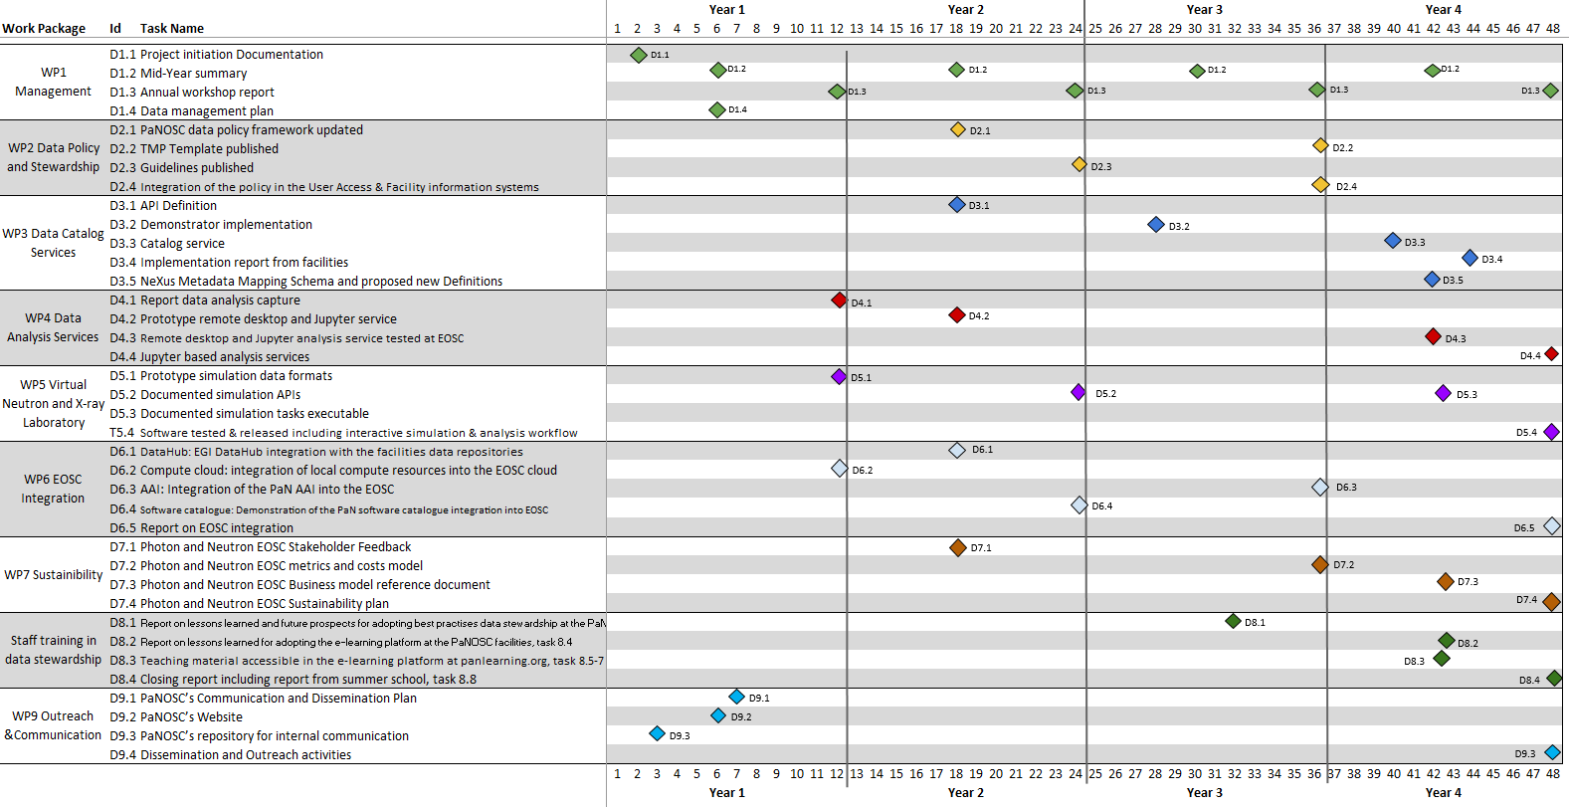
PaNOSC Deliverables
May 2019

Slide 14
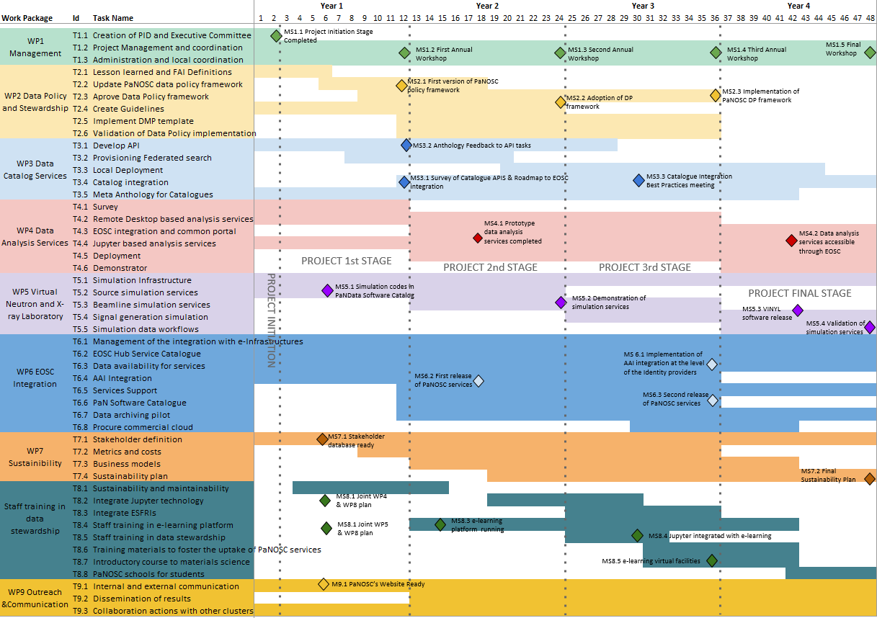
PaNOSC Milestones
May 2019

Slide 15
Deliverables status in May 2019
Completed
D1.1 – Project Initiation Documentation
D9.3 – Repository for internal communications
In progress
D1.2 – Mid-year summary
D1.4 – Data Management Plan
D9.2 – Website
This project has received funding from the European Union’s Horizon 2020 research and innovation programme under grant agreement No. 823852

Slide 16
Milestones status in May 2019
Completed
MS1.1 – Project Initiation Stage
MS5.1 – Simulation codes in PaNdata catalog
In progress
MS7.1 – Stakeholder database
MS8.1 – Joint WP4 and WP8 plan
MS8.1 – Joint WP5 and WP8 plan
MS9.1 – PaNOSC website ready
This project has received funding from the European Union’s Horizon 2020 research and innovation programme under grant agreement No. 823852

Slide 17
PaNOSC’s Objectives
Participate in the construction of the EOSC by linking with the e-infrastructures and other ESFRI clusters.
Make scientific data produced at Europe’s major Photon and Neutron sources fully compatible with the FAIR principles.
Generalise the adoption of open data policies, standard metadata and data stewardship from 15 photon and neutron RIs and physics institutes across Europe.
Provide innovative data services to the users of these facilities locally and the scientific community at large via the EOSC.
Increase the impact of RIs by ensuring data from user experiments can be used beyond the initial scope.
Share the outcomes with the national RIs who are observers in the proposal and the community at large to promote the adoption of FAIR data principles, data stewardship and the EOSC.
This project has received funding from the European Union’s Horizon 2020 research and innovation programme under grant agreement No. 823852

Slide 18
Objective 1 – Integrate RIs with EOSC
Participate in the construction of the EOSC by linking with the e-infrastructures and other ESFRI clusters.
Progress –
ILL (WP6 leader) has organised regular meetings (with minutes) Good interaction with EGI, GEANT GEANT working on prototype AAI based on eduTEAMS CESNET ready to deploy Jupyter service for PaNOSC (waiting for AAI) ILL, ESRF, CERIC participated in EOSC-hub week XFEL, ESRF, ILL to participate in EGI-week
Weaknesses –
No involvement from ELI, CERIC, ESRF in WP6 (so far) Problem of data transfer is not solved (Data One not the solution)
Next Steps –
Test FTS3 file transfer, Transfer large data volumes to STFC, Align configuration of Jupyter+Kubernetes in PaNOSC with EGI, Provision GPUs EOSC-hub to decide which solution to promote for AAI
This project has received funding from the European Union’s Horizon 2020 research and innovation programme under grant agreement No. 823852

Slide 19
Objective 2 – FAIR data
Make scientific data produced at Europe’s major Photon and Neutron sources fully compatible with the FAIR principles.
Progress –
ESRF (WP2 leader) has organised regular meetings (with minutes) Good interaction with EOSC-hub (recent deliverable D9.3 on data policy v. useful) Analysis of current data policies, what to keep and what to enhance CERIC started a Lessons learned document, ESRF wrote paper for SRN ESS attended the FAIRsFAIR kickoff, presented PaNOSC questions and established contact
Weaknesses –
No involvement from CERIC partners (so far) Adopting FAIR data policy for ELI (workshop in May) Modifying existing data policies (ILL, ESRF, XFEL, ESS)
Next Steps –
Complete Lessons learned document, Prepare draft FAIR-compliant Data Policy, Analyse best practices for metrics
This project has received funding from the European Union’s Horizon 2020 research and innovation programme under grant agreement No. 823852

Slide 20
Objective 3 – Open data policies
Generalise the adoption of open data policies, standard metadata and data stewardship from 15 photon and neutron RIs and physics institutes across Europe.
Progress –
Activities happening at each site e.g. ILL developed PUMA metrics tool (April) ESRF organising a plenary meeting with scientists (June) ELI organising workshop on data management (May)
Weaknesses –
No activities at CERIC partner sites e.g. Solaris, BNC, LASDAM, … Adopting FAIR data policy for ELI (workshop in May) Modifying existing data policies (ILL, ESRF, XFEL, ESS)
Next Steps –
Define KPIs for FAIR data policies and monitor, Analyse best practices for metrics e.g. Crossref, Altmetrics, PUMA, … Solaris to visit ESRF to study solutions for data management
This project has received funding from the European Union’s Horizon 2020 research and innovation programme under grant agreement No. 823852

Slide 21
Objective 4 – Data services
Provide innovative data services to the users of these facilities locally and the scientific community at large via the European Open Science Cloud (EOSC).
Progress –
Jupyter service is first common data service to be provided Work on setting up at ESRF, XFEL (DESY), ILL, ESS advancing EGI setup a demo service with limited resources ESRF organising OASYS school for designing+simulating beamlines
Weaknesses –
No common Jupyter installation (so far), each site doing their own No clear commitment from all partners which services they will provide
Next Steps –
Align Jupyter installations, Develop data visualisation for Jupyter notebooks Provide OASYS-as-a-service
This project has received funding from the European Union’s Horizon 2020 research and innovation programme under grant agreement No. 823852

Slide 22
Objective 5 – Sharing data
Increase the impact of RIs by ensuring data from user experiments can be used beyond the initial scope.
Progress –
ILL has developed PUMA service for tracking data production and (re)use WP3 developing a common API for search Open Data
Weaknesses –
No metrics for how much open data is and will be available Not clear how FAIRsFAIR, EUDAT, etc. will help with this
Next Steps –
Define and monitor metrics for Open Data
This project has received funding from the European Union’s Horizon 2020 research and innovation programme under grant agreement No. 823852

Slide 23
Objective 5 – Working with ExPANDS
Share the outcomes with the national RIs who are observers in the proposal and the community at large to promote the adoption of FAIR data principles, data stewardship and the EOSC.
Progress –
EXPaNDS, a consortium of national RIs, has been funded to provide FAIR data in EOSC First informal contact took place at EOSC-hub
Weaknesses –
EXPaNDS and PaNOSC end up not working closely together
Next Steps –
Define how PaNOSC and EXPaNDS will work together and share outcomes
This project has received funding from the European Union’s Horizon 2020 research and innovation programme under grant agreement No. 823852

Slide 24
PaNOSC - Software developments
AAI → ILL with GÉANT
Data catalogues → ICAT (ESRF), SciCat (ESS), MDC (EuXFEL), ILL
Common search API → ESS
E-logbook → ICAT+ (ESRF)
Jupyter on Kubernetes → ESRF, ILL, ESS, …
DAAS portal → Calipsoplus (ESRF+ALBA), Visa (ILL), …
Software catalogue → PaNdata catalogue (ILL)
Simulation software → Simex (EuXFEL), OASYS (ESRF)
e-Training platform → ESS, ELI,
This project has received funding from the European Union’s Horizon 2020 research and innovation programme under grant agreement No. 823852

Slide 25
Challenges
FAIR data – more difficult to implement than most believe
Implementing an electronic logbook as part of the RICH metadata capture
Promote use of Jupyter notebooks and workflows to capture data analysis
Integration - services linked by a supported federated identity scheme covering the research life cycle where users access data, software, IT capacity and the expertise for performing analysis
GEANT will help PaNOSC by hosting AAI, ESFRIs to provide expertise
Hybrid model - should not compete with but rather profit from user friendliness and innovation of commercial service providers
PaNOSC will procure and integrate commercial services
Provenance, citation and use of data & software
Train users to cite DOIs and provide Open Data
Business model of how to provide services to all scientists and general public
ESFRI Photon and Neutron RIs have funding for Users who come to the source, but no funding for providing services for using Open Data. Will EOSC provide resources?
This project has received funding from the European Union’s Horizon 2020 research and innovation programme under grant agreement No. 823852

